Slide 1
Kalman Filter
SARA Class Project
6438079621 Tinapat Game Limsila
Chulalongkorn University

Slide 2
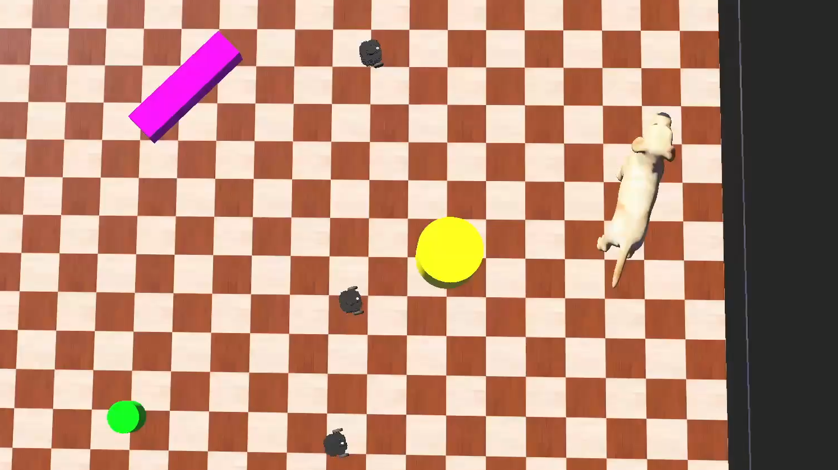

One—dimension position error PI system
Adapted from an existing project
Simulation
Simulation Background
Problem
Solution
Notes:
- Talk about adapting the existing problem with our project
- Reduction it to fits the needs of this project
- The input and output of the simulation, constraints and wh, talk about extended kalamn filter due to trig function
- Initiall issue of the result yielding good results due ot not using the prediction via prediction (USE human analogey)
- Flow chart of the logic of the kalman filter
- The result which it yield with mean squared erro

Slide 3
Simulation
Adapted from an existing project

Slide 4
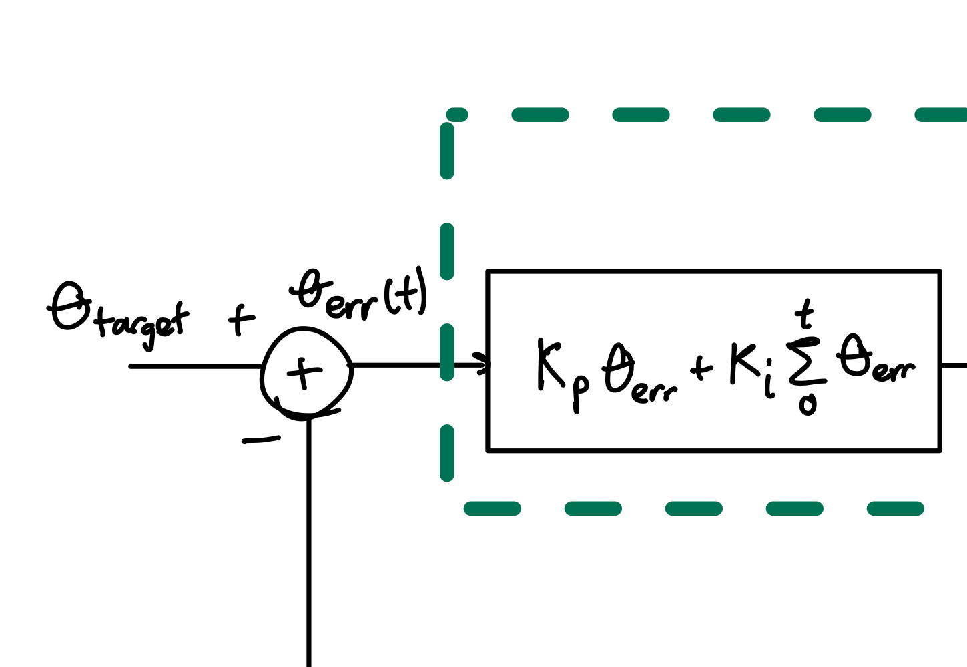
Reduction
Reduce the complex simulation to
a robot reaching a point in a straight line
The Original Project have Trig functions -> EKF

Slide 5
Reduction
The Original Project have Trig functions -> EKF

Slide 6
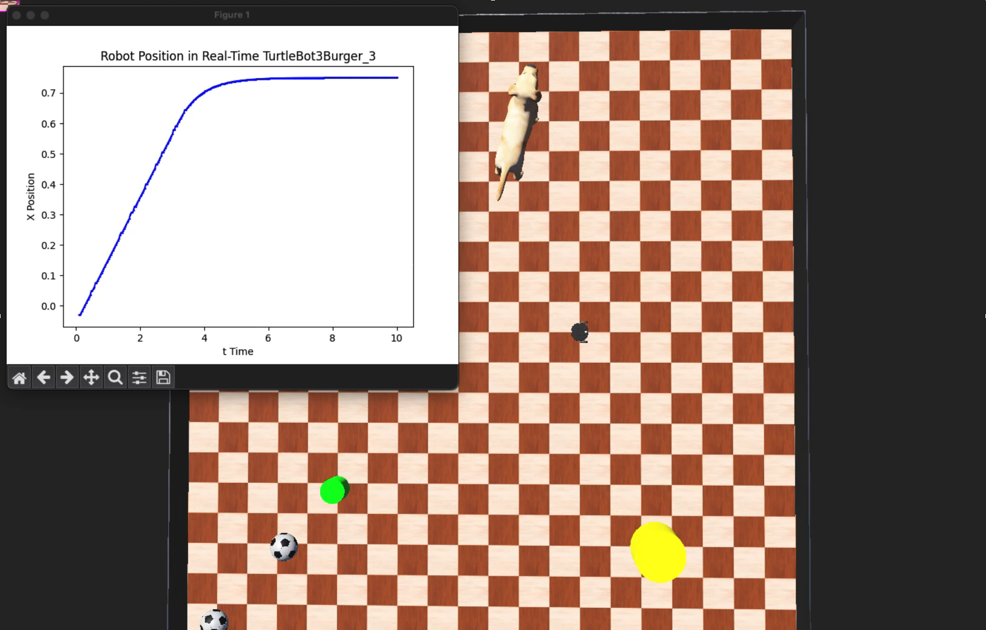
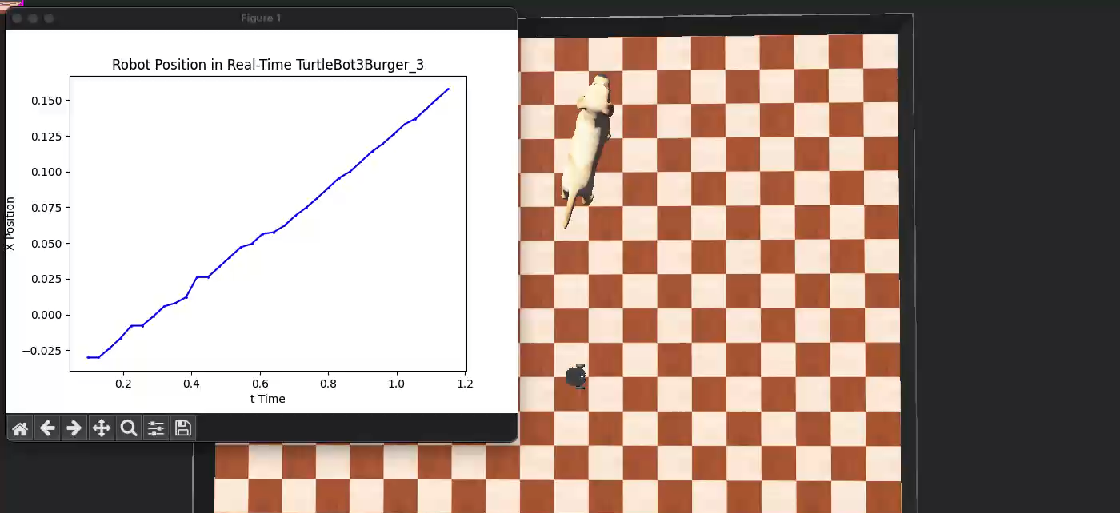
Base
a robot reaching a point in a straight line
- Fast rise-time
– Perfect Steady State
Base + Motor Drive Noise
Reduce the complex simulation to
a robot reaching a point in a straight line.

Slide 7
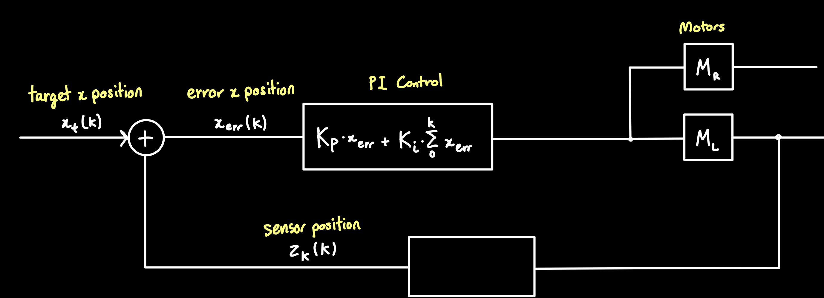
Control Logic

Slide 8
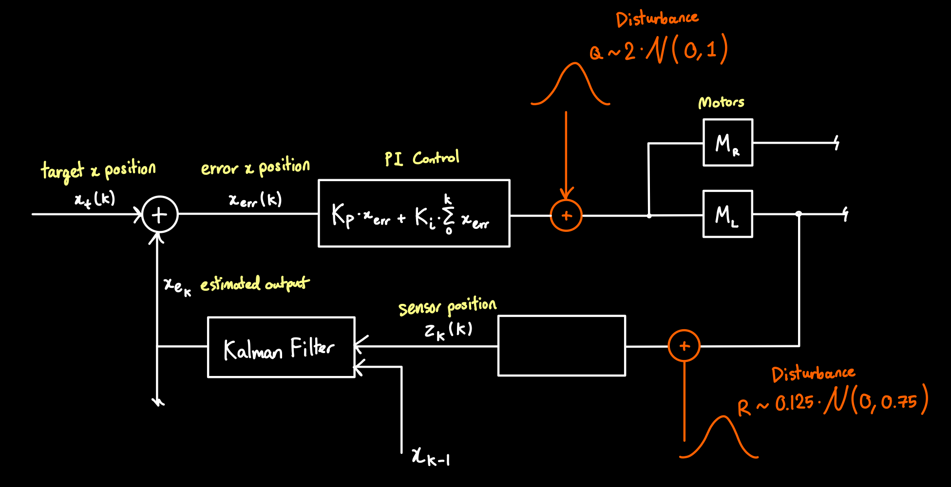
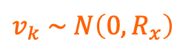
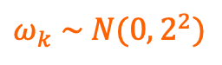
Control Logic
$ω_{k} \sim N(0,2^{2})$
$$v_{k} \sim N\left(0,R_{x}\right)$$

Slide 9
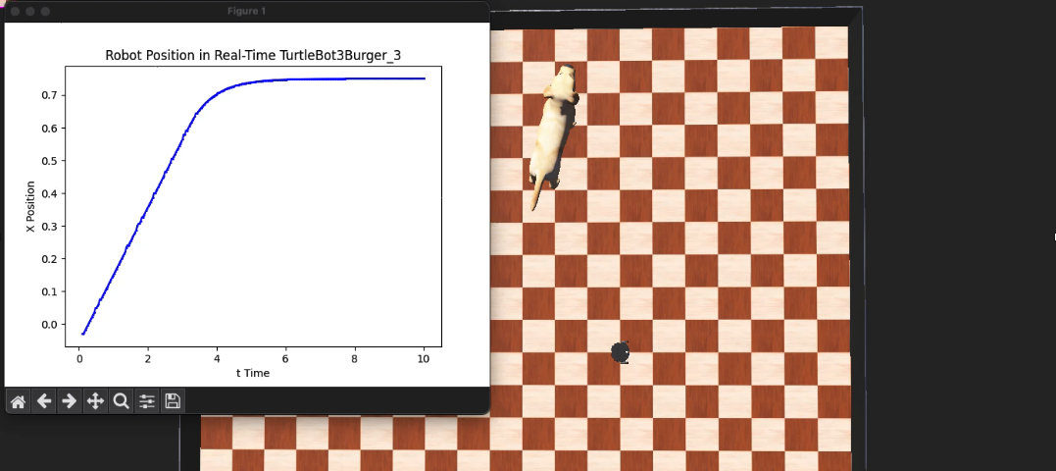
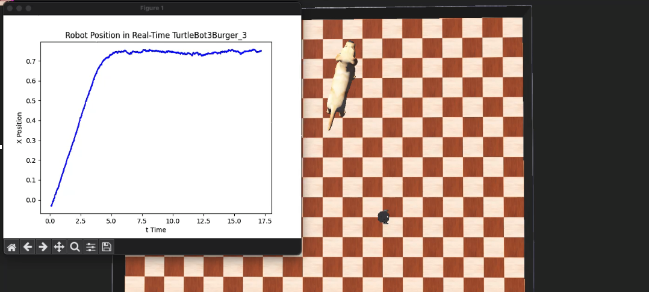
Base
Base + Motor Drive Noise (Q)
Adding a bit of noise, motor driver output to motors
Meters per Second
Reduce the complex simulation to
a robot reaching a point in a straight line.
Base + Motor Drive & Sensor Noise (Q,R)
Kalman Filter

Slide 10
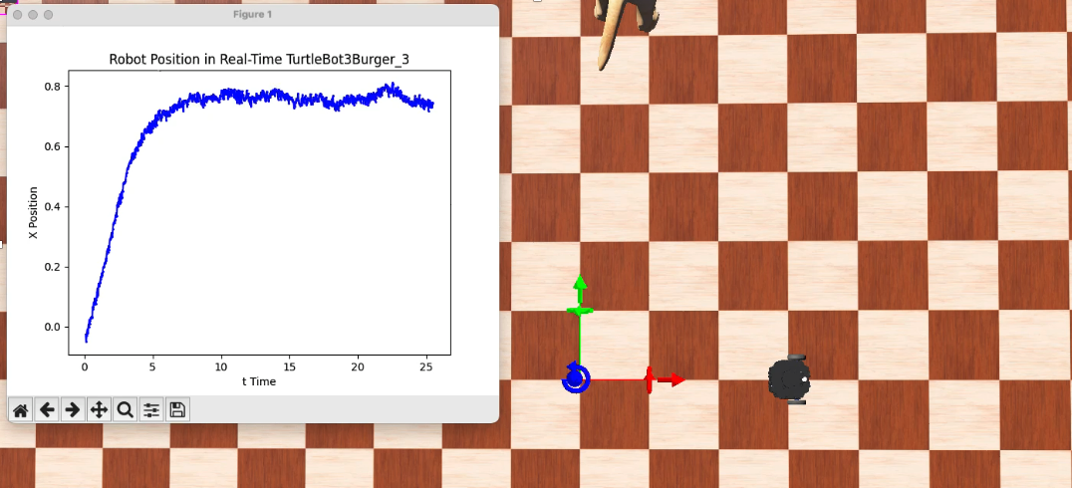
Base
Base + Motor Drive Noise (Q)
Base + Motor Drive & Sensor Noise (Q,R)
- Adding lots of noise, encoder of the left wheel
- Radians per second
Kalman Filter

Slide 11
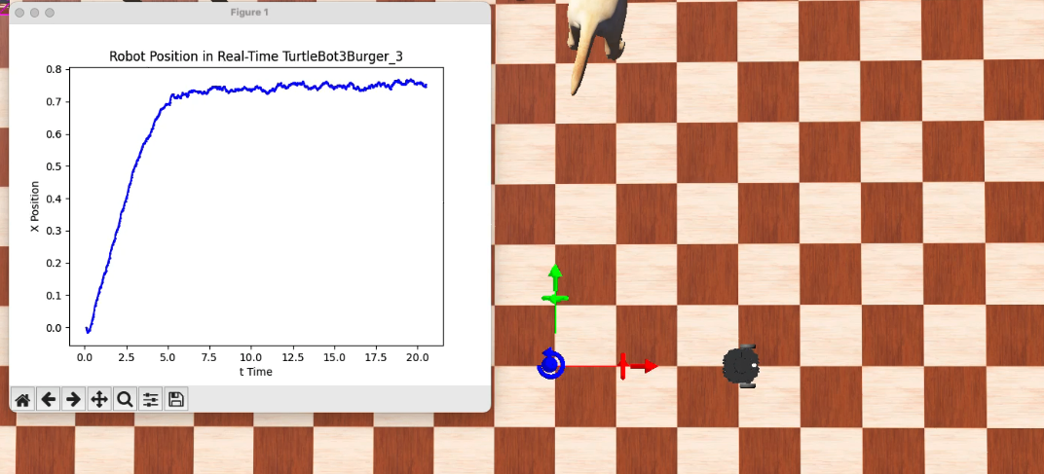
Base
Base + Motor Drive Noise (Q)
Base + Motor Drive & Sensor Noise (Q,R)
Kalman Filter for (Q,R)
Notes:
3 robots with path finding and object detection

Slide 12
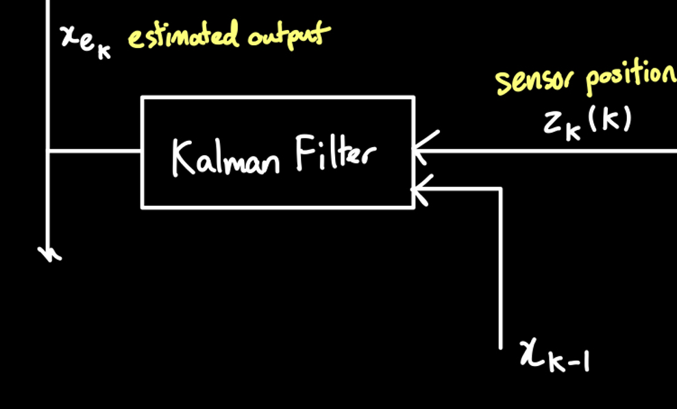







Kalman
$$\text{1}\text{. }\text{Initalise} \text{System} \text{State}\text{ \& }\text{Estimation}$$
$$A=\left[\begin{matrix}1 & △t \\ 0 & 1\end{matrix}\right]$$
$$H=\left[\begin{matrix}1 & 0 \\ 0 & 0\end{matrix}\right]$$
3. Compute Kalman Gain at k
$K_{k}=P_{p,k}H^{T}$ ${(HP_{p,k}H^{T}+R)}^{−1}$
$X_{e,0}$ $=[\begin{matrix}0 \\ 0\end{matrix}]$
$P_{0}$ $=\left[\begin{matrix}0 & 0 \\ 0 & 0\end{matrix}\right]$
4. Estimate System State at k
$$X_{e,k}=X_{p,k} −K_{k}Z_{k}−HX_{p,k}$$
$$P_{e,k}=P_{p,k} −K_{k}HP_{p,k}$$
2. Predict System State at k from k-1
$$X_{p,k}=AX_{e,k−1}$$
$$P_{p,k}=AP_{e,k−1} A^{T}+Q$$
$$Q=\left[\begin{matrix}\text{1.3639}\text{e}\text{−6} & 0 \\ 0 & \text{1.12270}\text{e}\text{−4}\end{matrix}\right]$$
$$R= \left[\begin{matrix}\text{8.7891}\text{e}\text{−}5 & 0 \\ 0 & \text{8.5831}\text{e}\text{−}2\end{matrix}\right]$$
Notes:
SAY EDUCATED GUESS
Most good manufacture should have these figures

Slide 13


Kalman
$$\text{1}\text{. }\text{Initalise} \text{System} \text{State}\text{ \& }\text{Estimation}$$
$$A=\left[\begin{matrix}1 & △t \\ 0 & 1\end{matrix}\right]$$
$$H=\left[\begin{matrix}1 & 0 \\ 0 & 0\end{matrix}\right]$$
$X_{e,0}$ $=[\begin{matrix}0 \\ 0\end{matrix}]$
$P_{0}$ $=\left[\begin{matrix}0 & 0 \\ 0 & 0\end{matrix}\right]$
3. Compute Kalman Gain at k
$K_{k}=P_{p,k}H^{T}$ ${(HP_{p,k}H^{T}+R)}^{−1}$
4. Estimate System State at k
$$X_{e,k}=X_{p,k} −K_{k}Z_{k}−HX_{p,k}$$
$$P_{e,k}=P_{p,k} −K_{k}HP_{p,k}$$
2. Predict System State at k from k-1
$$X_{p,k}=AX_{e,k−1}$$
$$P_{p,k}=AP_{e,k−1} A^{T}+Q$$
$$Q=\left[\begin{matrix}\text{1.3639}\text{e}\text{−6} & 0 \\ 0 & \text{1.12270}\text{e}\text{−4}\end{matrix}\right]$$
$$R= \left[\begin{matrix}\text{8.7891}\text{e}\text{−}5 & 0 \\ 0 & \text{8.5831}\text{e}\text{−}2\end{matrix}\right]$$
Notes:
SAY EDUCATED GUESS
Most good manufacture should have these figures

Slide 14

Kalman
$$\text{1}\text{. }\text{Initalise} \text{System} \text{State}\text{ \& }\text{Estimation}$$
$$A=\left[\begin{matrix}1 & △t \\ 0 & 1\end{matrix}\right]$$
$$H=\left[\begin{matrix}1 & 0 \\ 0 & 0\end{matrix}\right]$$
$X_{e,0}$ $=[\begin{matrix}0 \\ 0\end{matrix}]$
$P_{0}$ $=\left[\begin{matrix}0 & 0 \\ 0 & 0\end{matrix}\right]$
2. Predict System State at k from k-1
$$X_{p,k}=AX_{e,k−1}$$
$$P_{p,k}=AP_{e,k−1} A^{T}+Q$$
3. Compute Kalman Gain at k
$K_{k}=P_{p,k}H^{T}$ ${(HP_{p,k}H^{T}+R)}^{−1}$
4. Estimate System State at k
$$X_{e,k}=X_{p,k} −K_{k}Z_{k}−HX_{p,k}$$
$$P_{e,k}=P_{p,k} −K_{k}HP_{p,k}$$
$$Q=\left[\begin{matrix}\text{1.3639}\text{e}\text{−6} & 0 \\ 0 & \text{1.12270}\text{e}\text{−4}\end{matrix}\right]$$
$$R= \left[\begin{matrix}\text{8.7891}\text{e}\text{−}5 & 0 \\ 0 & \text{8.5831}\text{e}\text{−}2\end{matrix}\right]$$
Notes:
SAY EDUCATED GUESS
Most good manufacture should have these figures

Slide 15

Kalman
$$\text{1}\text{. }\text{Initalise} \text{System} \text{State}\text{ \& }\text{Estimation}$$
$$A=\left[\begin{matrix}1 & △t \\ 0 & 1\end{matrix}\right]$$
$$H=\left[\begin{matrix}1 & 0 \\ 0 & 0\end{matrix}\right]$$
3. Compute Kalman Gain at k
$K_{k}=P_{p,k}H^{T}$ ${(HP_{p,k}H^{T}+R)}^{−1}$
$X_{e,0}$ $=[\begin{matrix}0 \\ 0\end{matrix}]$
$P_{0}$ $=\left[\begin{matrix}0 & 0 \\ 0 & 0\end{matrix}\right]$
2. Predict System State at k from k-1
$$X_{p,k}=AX_{e,k−1}$$
$$P_{p,k}=AP_{e,k−1} A^{T}+Q$$
4. Estimate System State at k
$$X_{e,k}=X_{p,k} −K_{k}Z_{k}−HX_{p,k}$$
$$P_{e,k}=P_{p,k} −K_{k}HP_{p,k}$$
$$Q=\left[\begin{matrix}\text{1.3639}\text{e}\text{−6} & 0 \\ 0 & \text{1.12270}\text{e}\text{−4}\end{matrix}\right]$$
$$R= \left[\begin{matrix}\text{8.7891}\text{e}\text{−}5 & 0 \\ 0 & \text{8.5831}\text{e}\text{−}2\end{matrix}\right]$$
Notes:
SAY EDUCATED GUESS
Most good manufacture should have these figures

Slide 16



Kalman
$$\text{1}\text{. }\text{Initalise} \text{System} \text{State}\text{ \& }\text{Estimation}$$
$$A=\left[\begin{matrix}1 & △t \\ 0 & 1\end{matrix}\right]$$
$$H=\left[\begin{matrix}1 & 0 \\ 0 & 0\end{matrix}\right]$$
3. Compute Kalman Gain at k
$K_{k}=P_{p,k}H^{T}$ ${(HP_{p,k}H^{T}+R)}^{−1}$
$X_{e,0}$ $=[\begin{matrix}0 \\ 0\end{matrix}]$
$P_{0}$ $=\left[\begin{matrix}0 & 0 \\ 0 & 0\end{matrix}\right]$
4. Estimate System State at k
$$X_{e,k}=X_{p,k}+K_{k}(Z_{k}−HX_{p,k})$$
$$P_{e,k}=P_{p,k} −K_{k}HP_{p,k}$$
2. Predict System State at k from k-1
$$X_{p,k}=AX_{e,k−1}$$
$$P_{p,k}=AP_{e,k−1} A^{T}+Q$$
$$Q=\left[\begin{matrix}\text{4}\text{.}\text{2621}\text{e}\text{−5} & 6.1363e−5 \\ 6.1363e−5 & \text{3}\text{.}\text{5084}\text{e}\text{−3}\end{matrix}\right]$$
$$R= \left[\begin{matrix}\text{8.7891}\text{e}\text{−}5 & \text{2.7465}\text{e}\text{−}3 \\ \text{2.7465}\text{e}\text{−}3 & \text{8.5831}\text{e}\text{−}2\end{matrix}\right]$$
Notes:
SAY EDUCATED GUESS
Most good manufacture should have these figures

Slide 17
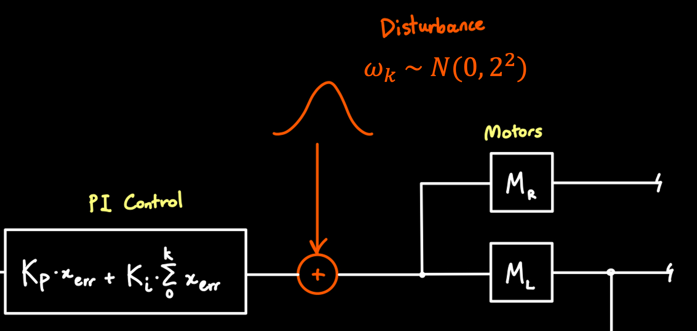
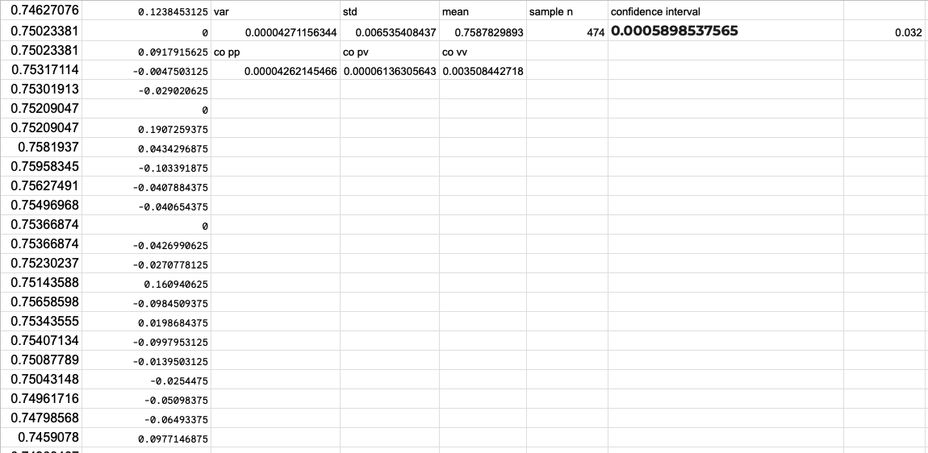



Q Matrix
Value $R_{x}$ used in noise generation, $ω_{k} \sim N(0,2^{2})$
Record position during steady state using perfect sensor
Calculate v from x
Calculate the covarriance Q
$$Q=\left[\begin{matrix}Cov(x,x) & Cov(x,v) \\ Cov(x,v) & Cov(v,v) \end{matrix}\right]$$
$$Q=\left[\begin{matrix}\text{4}\text{.}\text{2621}\text{e}\text{−5} & 6.1363e−5 \\ 6.1363e−5 & \text{3}\text{.}\text{5084}\text{e}\text{−3}\end{matrix}\right]$$
Notes:
SAY EDUCATED GUESS
MEASURING USING. PERFECT SENSOR
No noise in the in the correlation converting velocity to position
Justification using delta T
Q measure. The uncertainty of the system, time dependant, reduce the cummalatiuve affect (GOOD RESULTS)
R is independent from time

Slide 18
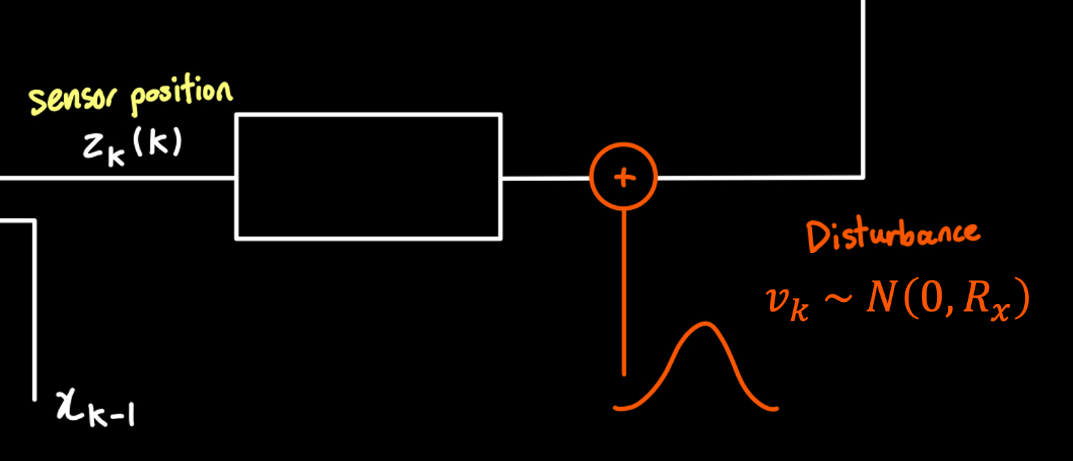










R Matrix
Using the determined values ${(σ}_{x}, a, △t)$ for $R_{x}$
Value $R_{x}$ used in noise generation, $v_{k} \sim N\left(0,R_{x}\right)$
Value $R_{x}$ used as Kalman Filter Parameter
$$Varience={(σ_{x}∙a)}^{2}=2^{2}$$
$$σ_{x}=0.75$$
$$a=0.0125$$
$$△t=0.032$$
$$R_{x}={(σ_{x}∙a )}^{2}$$
$$R_{v}={R_{x} /(△t)}^{2}$$
$$R=\left[\begin{matrix}R_{x} & … \\ … & R_{v}\end{matrix}\right]$$
$$R= \left[\begin{matrix}\text{8.7891}\text{e}\text{−}5 & \text{2.7465}\text{e}\text{−}3 \\ \text{2.7465}\text{e}\text{−}3 & \text{8.5831}\text{e}\text{−}2\end{matrix}\right]$$
$$Q=\left[\begin{matrix}\text{1.3639}\text{e}\text{−6} & 0 \\ 0 & \text{1.12270}\text{e}\text{−4}\end{matrix}\right]$$
Notes:
SAY EDUCATED GUESS
Most good manufacture should have these figures

Slide 19
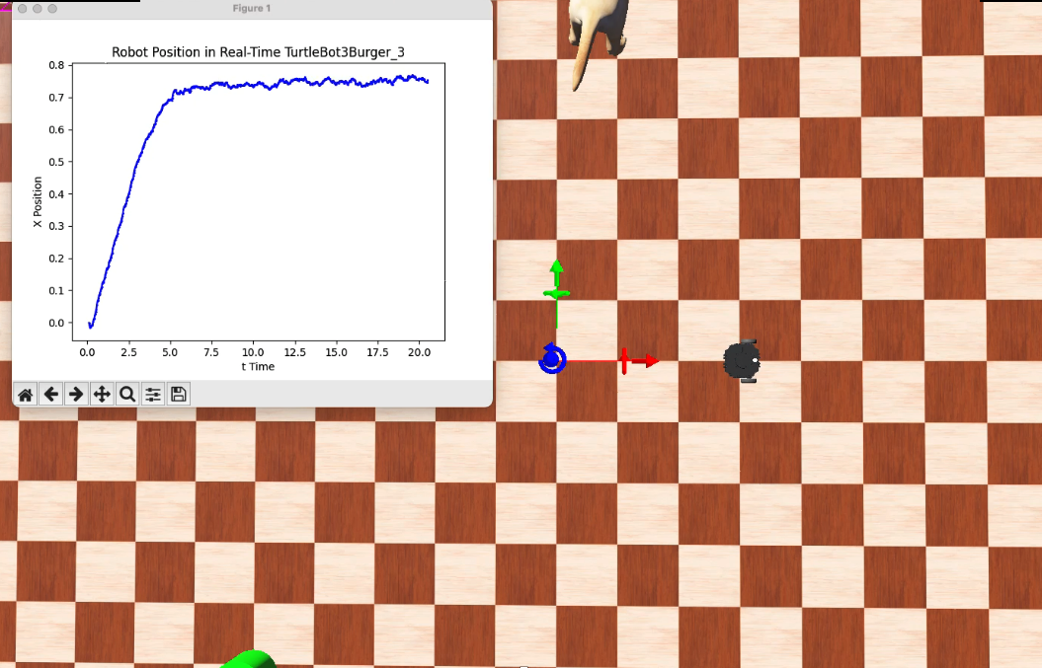
Kalman
Range from 10 – 20s (900 samples)
@ Steady State | without Kalman Filter | with Kalman Filter | Improvement with Kalman
Mean | 0.75274 | 0.74758 | 13.2%
Standard Deviation | 0.016383 | 0.010421 | 36.3%
95% Confidence | 0.75274 + 0.0010601 | 0.74758 + 0.00069027 | 53.5%
Notes:
SAY EDUCATED GUESS
Most good manufacture should have these figures

Slide 20
Questions?
Notes:
SAY EDUCATED GUESS
Most good manufacture should have these figures

